Slide 1
Microservices
Communication

Slide 2
Content
Overview
REST
gRPC
MQTT (in an IoT World)
Backend 4 Frontend Pattern (REST)
graphQL

Slide 3
Overview
External and
Internal Communicaton between User and
different microservices via graphQL, REST over HTTP, gRPC, ...

Slide 4
REST – Fundamentals & Best Practises
➔ VV Semester 4
Resources
Nouns, not Verbs
Coarse Grained, not Fine Grained
Architectural style for use-case scalability
Keep It Simple
Collection Resource /users/
Instance Resource /users/1
Behavior
GET, PUT, POST, DELETE („CRUD“), Head (Headers, no Body)
Use HTTP Reponse Codes
Date/Time/Timestamp
ISO 8601 is the standard
Use UTC!
Use query params for offset and limit
....

Slide 5
REST – Accept CORS
Cross-Origin Resource Sharing (CORS) is a mechanism that uses additional HTTP headers to let a user agent gain permission to access selected resources from a server on a different origin (domain) than the site currently in use.
https://developer.mozilla.org/en-US/docs/Web/HTTP/CORS

Slide 6
REST – API Anti Patterns!
Poor error handling
REST APIs that ignore HTTP rules
Exposing your raw underlying data model
Security complexity
Unexpected & undocumented releases
Poor developer expereience
Poor documentation

Slide 7
REST
RESTful API
GET /user/1
{
„username“: „jona7o“,
„email“: „tobias.jonas@fh-rosenheim.de“,
...
}
Non-RESTful API
GET /last_active_users?page=3
{
„users“: [...]
...
}
/// more shit
/getAccount
/getAllAccounts
/verifyAccountEmailAddress
/searchGroupsByName
Smells like bad RPC. DON‘T DO THIS!! Then look at gRPC!!!
I am getting frustrated by the number of people calling any HTTP-based interface a REST API – Roy Fielding

Slide 8
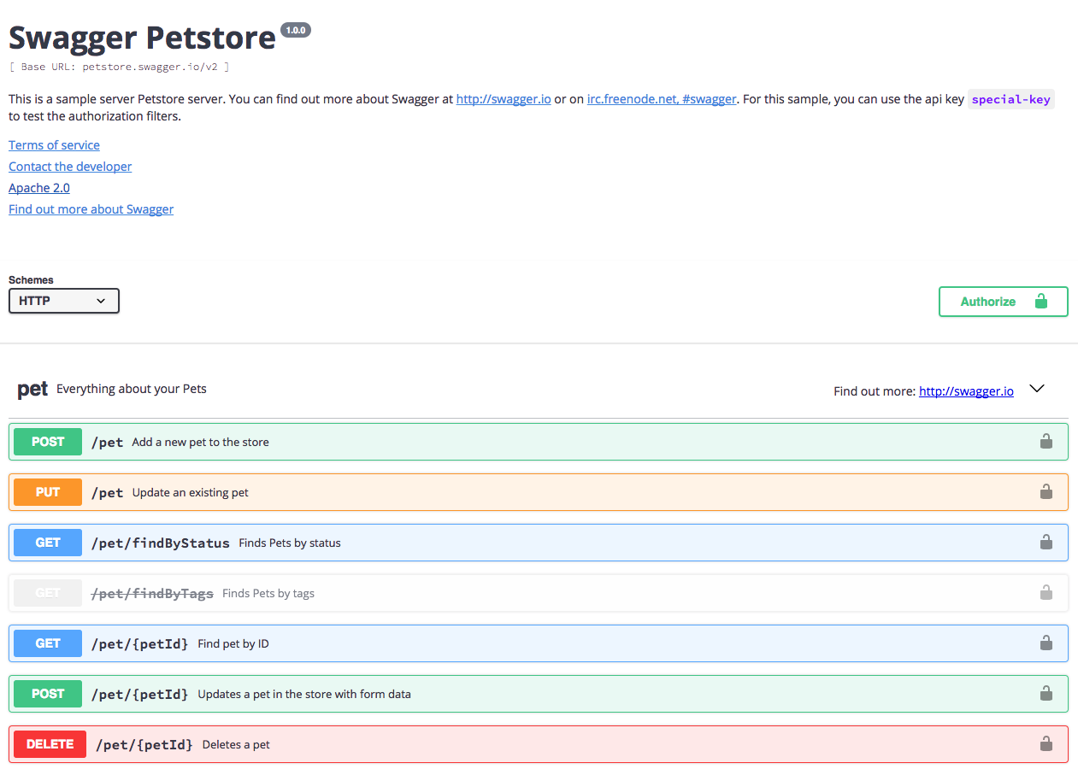
REST – OpenAPI as API documentation
Framework for describing APIs for the discovery of APIs by humans and machines
You can generate your swagger documentation from code
Or you can generate code for your API Endpoints
YAML or JSON file
https://www.openapis.org/
Swagger is the most popular API Tool
https://swagger.io/

Slide 9
gRPC
gRPC stands for gRPC (Remote Procedure Calls)
A high performance, general purpose, feature-rich RPC framework (RPC ➔ 4. Semester VV Prof. Beneken)
Part of Cloud Native Computing Foundation cncf.io
HTTP/2 and mobile first
Open sourced version of Stubby RPC used in Google
gRPC is not RMI
Abstractions and best practices on how to design RPCs
more gRPC in presentation from 23.11.2017

Slide 10
MQTT
MQTT: Message Queue TelemetryTransport
Very lightweigth messaging protocol – used in IoT World
Publish/Subscribe Architecture
3 QOS Levels higher
higher level → more server resources needed
higher level → more bandwidth needed
A lot of clients on a single server
more MQTT in presentation from 23.11.2017

Slide 11
Backend 4 Frontend
Backend 4 Frontend
#1
#2
#3
#4

Slide 12
What is graphQL
A query language for your API
Created by Facebook in 2012
Key conecpts of the graphQL query language are
hierachrical
product-centric
strong-typed
Introspective
Why graphQL?
Ask for what you need, get exactly that
Get many resources in a single request
Describe what‘s possible with a type system
Move faster with powerful developer toools
Evolve your API without versions
Bring your own data and code
https://www.slideshare.net/Codemotion/tomer-elmalem-graphql-apis-rest-in-peace-codemotion-milan-2017
https://apis.guru/graphql-voyager/

Slide 13
REST vs. graphQL
GET /products/:productId/comments
GET /comments/:commentId/pictures
(for each commentId)
REST CLIENT
graphQL Client
{
data: [
{ id: 1, data: ‘..‘},
{ id: 2, data: ‘..‘},
]
}
{
comments(<productId>){
id,
data,
pictures {
url
}
}
}
{
data: [
{ pictureid: 1, url: ‘..‘},
{ pictureid : 2, url: ‘..‘},
]
}
REST CLIENT
graphQL Server

